Slide 1
Project Management:
Process, Technology, and Practice
Ganesh Vaidyanathan
Chapter 10
Project Closure

Slide 2
Learning objectives
Implement a project audit process
Close projects
Implement a post-implementation process
Use Project Issue Log in all reviews
Use various techniques that are available for post-implementation of project

Slide 3
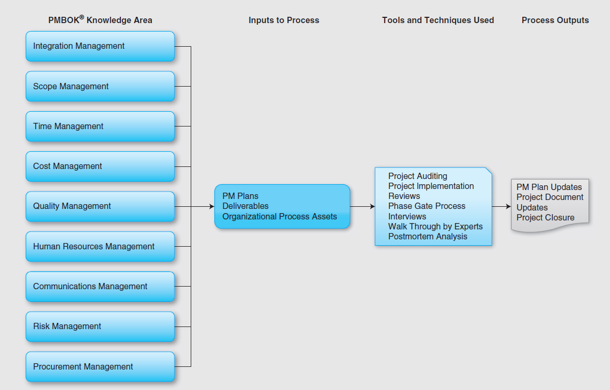

Slide 4
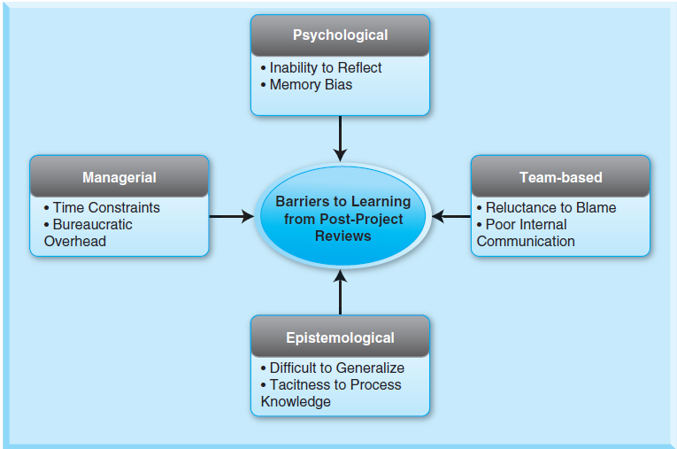
Post-implementation Review Problems

Slide 5
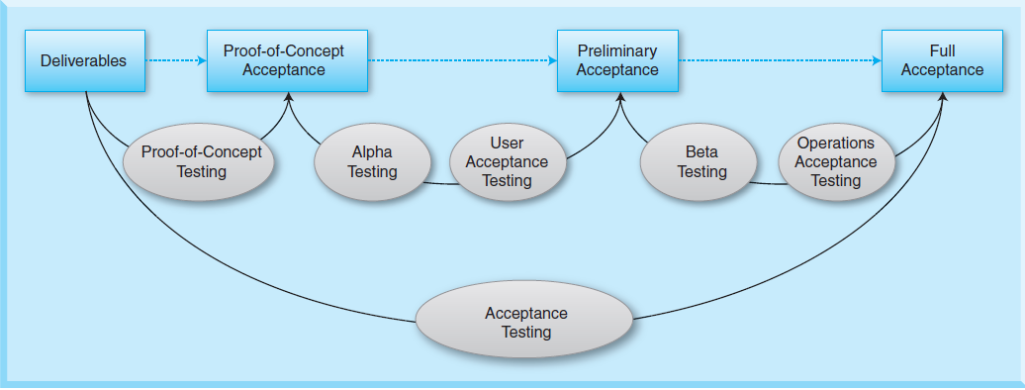
Project Acceptance

Slide 6
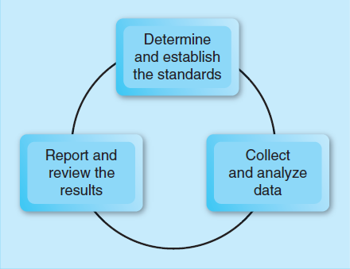
Project Audits and Project Audit Process
A project audit should contain the following:
• Project status including scope, cost, schedule, progress metrics, safety metrics, performance, how efficiently resources are being used, and expected value of the project
• Future projections
• Status of crucial tasks
• Risk assessment
• Information relevant to other projects
• Limitations of the audit

Slide 7
Why Audit a Project?
To find the reasons for problems and issues in the project and answer questions posed by the customer, sponsor, executives, or other stakeholders including:
Is the project scope under control?
What is the current state of the project?
Will the project meet the requirements?
Is the technical approach being used appropriate for the project?
Is the project plan being followed?
Does the project follow all project processes, procedures, and guidelines?

Slide 8
Why Audit a Project?
Is the project following the best practices in the industry?
What improvements should be made?
Does the project manager communicate effectively with all project stakeholders?
Does the project team take rational and correct decisions?
Is the project team working effectively and efficiently?
Does the project authority work?
Is the project progressing effectively and efficiently?
Is the technology used in this project “industry standard”?
Is this the best technology for this project?
How are the decisions made?

Slide 9
Why Audit a Project?
Are the quality terms defined well, and are they being followed?
Is the project making sufficient progress toward predicted performance?
Is the project making progress based on its scope?
Were the safety rules and regulations followed?
Is the project working within county, state, and federal compliances?
Will the project provide value to the stakeholders?

Slide 10
Benefits of Project Auditing
Provides a level of comfort to management providing assurance
Provides a prioritized list of problematic activities that need to be addressed
Provides project details with a known degree of uncertainty
Reduces project risks
Reduces time and cost overruns during execution
Gathers valuable knowledge and experience
Recommendations from the audit results may be used to improve project execution and reduce time and cost overruns in current and future projects

Slide 11
Project Auditing
A project audit should contain the following:
Project status including scope, cost, schedule, progress metrics, safety metrics, performance, how efficiently resources are being used, and expected value of the project
Future projections
Status of crucial tasks
Risk assessment
Information relevant to other projects
Limitations of the audit

Slide 12
Project Closure
Premature projects
Endless projects
Failed projects
Complete projects

Slide 13
Early Project Closure
Incomplete requirements: Unclear and inadequate requirement gathering process; may also be due to uncommitted or uninformed stakeholders
Lack of user involvement: Due to miscommunications between the users and the project managers in an organization
Lack of resources: Poor business value, may result in reduced resources and project reprioritization; decreased project value may result from poor project management
Unrealistic expectations: High user expectations coupled with the lack of user involvement will terminate a project quickly

Slide 14
Early Project Closure
Lack of executive support: Management must be involved from the beginning and must remain involved in the project by monitoring the progress of the project, making the path of progress clear of any obstacles, and providing the general direction towards success.
Scope changes: Project managers recognize large scope changes in a project but are not as careful and diligent on smaller changes to the project scope. The cumulative effects of all the small changes can overload a project with extra work, overburden the budget, cause delays in the project, and may result in project termination.
Technology: Technology illiteracy of performers or managers can terminate a project.

Slide 15
Early Project Closure
Market forces: The value of a project can be diminished by the sudden availability of alternative or competing technological innovations or change on market conditions.
Economic factors: When an organization fails to achieve its financial expectations, it may reevaluate the ongoing projects and terminate those projects that promise less value.
Environment and Legal Factors: Environment factors and legal factors also have a significant influence on a project’s value. A project, which is on schedule and well within its budget, may be terminated due to new regulatory measures or legal ramifications.

Slide 16
Project Closure Decision
Administrative Closure
The administrative closure activities relate to the management of a project and the following issues have to be addressed during the administrative closure:
Implementing and quantifying all tests related to the product, system or service
Establishing a plan to review and analyze any open issues
Deciding how project records will be collected along with the responsible persons
Analyzing project success or failure

Slide 17
Project Closure Decision
Administrative Closure
Gathering lessons learned
Planning for knowledge transfer
Establishing project value
Deciding how to manage the communication related to closure
Archiving project information and update knowledge base
Performing an post-implementation review
Shutting down the project office

Slide 18
Project Closure Decision
Contract Closure
Formalize the acceptance of the project outcome and deliverables.
Identify, determine, and document acceptance criteria.
Identify scope and how scope was met.
Make sure that the client or end user is fully satisfied with the results.
Update the contract document as needed per changes.

Slide 19
Project Closure Decision
Handover of Project Results
Determine what end-user training is required and who will provide the training and when.
Finalize all contractual obligations, and identify who will formally approve the transition process and obtain approval.
Recognize the project team for their accomplishment. Consider a project completion celebration for the team, the end users, and other key stakeholders. This is a great opportunity to recognize a job well done as it can motivate workers as they prepare for their next assignment. It is important to recognize the achievement of the individual team members both privately and publicly.

Slide 20
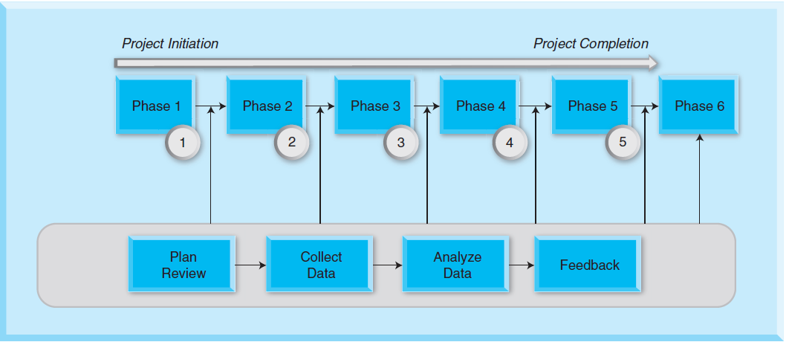
Project Implementation Review
Stage Project Implementation Review (SPIR), and
Post Project Implementation Review (PPIR)

Slide 21
Surveys
The Project Manager must stress to all survey participants the importance of their honest feedback as one of the primary mechanisms for assessing the project’s performance. The survey should include the following areas:
Project Effectiveness to identify how effective the product or service met customer needs and project scope
Communications Management to understand the effectiveness of the plan developed for the project
Risk Management to identify effectiveness of risk management, of risks that actually occurred, and of the mitigation plan

Slide 22
Surveys
Change Management to determines the effectiveness of the change management activities
Project Implementation that considers effectiveness of planned activities
Project Performance that considers effectiveness of project performance throughout the project life span
Team performance to determine the effectiveness of the project team, and
Customer acceptance to understand how customers perceived project deliverables.

Slide 23
Interviews
What were the issues in the project and what can be done differently to avoid those issues?
What is satisfying about this project?
Which processes worked particularly well?
Did the requirements gathering or market analysis or feasibility study identify all the project deliverables? If not, what was missed and what can be done to ensure future analyses don’t miss such items?
Did our needs/market analysis or feasibility study identify unnecessary deliverables? If so, how can we be sure our future analyses don’t make this mistake?
How accurate were our original cost, schedule, and resource estimates ?

Slide 24
Interviews
Was the project scope accomplished in its entirety?
What can be done to improve estimating costs, schedule and resources?
Was the expected value realized?
Were all quality performance factors met?
Was the project assigned the right people?
Were there any early warning signs of problems that occurred later in the project?
How should the project team have reacted to these signs?
Could we have completed this project with fewer contractors or suppliers or outsourced personnel?

Slide 25
Interviews
Were there any difficulties negotiating with vendors? How can we negotiate be improved?
Were all team members active in meetings, reviews, and project activities?
How can team members be better motivated?
Were all milestones met? How could missed ones have been met?
Were all deliverables satisfactory to customers and users?
Were the facilities, equipment, materials, and support people help to achieve project goals?

Slide 26
Final reports
Performance reports need to be reviewed during the evaluation. The performance evaluation should include the following:
Scope of the project including progress of critical tasks, achieved milestones
Cost files including budget, over-budget tasks, earned value, and cash flow of the project
Resource files including to-do lists, resource expenses, and over-allocated resources
Schedule files including un-started tasks, tasks starting soon, task sin progress, completed tasks, slipping tasks
Performance metrics as determined at the start of the project, and
Overall value of the project.

Slide 27
Post mortem Analysis
The analysis of the data collected is the most costly, time-consuming, and difficult part in this process.
The data have to be read accurately in order to complete the analysis successfully.
Proper tools have to be identified and employed to analyze data, and statistical analysis of the survey results has to be used to understand the collected data. Visualization graphical tools such as Microsoft Excel can be used to better understand the data.

Slide 28
Post mortem Analysis
As soon as the projects are completed, organizations move on due to pressure from within to initiate new projects.
Organizations do not commit themselves to analyzing projects once they are completed.
A comprehensive analysis in the five areas of the technical objectives, budget, resources, project termination, and implications due to the technology and the project management is recommended.
The data collected during the post-implementation of projects can be analyzed to provide useful information.

Slide 29
Post mortem Analysis
Factors | Questions
Scope | Were the scope of the project and project objectives clearly defined?
 | Did the project scope change during the project? If so, why?
Cost | Did the actual outcome meet the expected outcome of the project in terms of cost?
Schedule | Did the actual outcome meet the expected outcome of the project in terms of schedule?
 | Were the project activities and milestones clearly defined?

Slide 30
Post mortem Analysis
Factors | Questions
Resources | Were all roles, responsibilities, and accountabilities clearly defined and followed?
 | Was the project resourced adequately?
 | How was the commitment of the project manager and project team?
Performance | Did the actual outcome meet the expected outcome of the project in terms of quality and performance?
 | Did the actual outcome meet the expected outcome of the project in terms of performance of resources?

Slide 31
Post mortem Analysis
Factors | Questions
Value | How is the sponsor’s commitment to the project?
 | If there were any variances, what was the reason for those variances?
 | Were the project stakeholders satisfied on the outcome of the project?
 | Did the actual outcome meet the expected outcome of the project in terms of project value?
 | Were the expected benefits of the project realized?
 | Was the decision to undertake this project correct?

Slide 32
Summary
Auditing is a systematic process of objectively obtaining and evaluating evidence regarding assertions about economic actions and events to ascertain the degree of correspondence between these assertions, establishing criteria, and communicating the results to interested users.
A project audit provides the opportunity to uncover the issues, concerns, and challenges encountered during the execution of a project.
The project audit captures a view of what went well and what needs to be improved with the project to successfully complete it.
If a project is audited at its closure, the audit can be used to develop success criteria for future projects as the audit provides a postmortem of the project.

Slide 33
Summary
A review resulting from this type of audit illustrates successfully managed factors of the project as well as which factors posed challenges.
The lessons learned from a project audit will help to better manage future projects.
Project audits can be conducted at any point of a project. In-process audits are those conducted early in a project or during its progress at a predetermined time. This type of audit helps to correct and change a project during its progress.
The closure of a project is certain, but how the project is terminated and at what point in its implementation it is terminated have a profound impact on an organization and its employees.

Slide 34
Summary
The success of future projects also depends on how unsuccessful projects were treated by an organization and its stakeholders. Therefore, the closure or termination of a project is important when the project has failed.
Project terminations cannot be equated to project failure, and poor management may or may not be a factor in early project closure.
Early project closure is signaled by factors regarding how the project was initiated, planned, and implemented.
Project closure may happen due to incomplete requirements, lack of user involvement, lack of resources, unrealistic expectations, lack of executive support, scope changes, new technology, and economic factors. There are three ways to terminate a project: extinction, inclusion, or integration.

Slide 35
Summary
Project implementation reviews are processes to reflect on and evaluate a project either during the progress of a project or after project closure. Project implementation reviews are of two different types: SPIR and PPIR.
PPIR is conducted at the end of the project, and SPIRs are conducted at the end of each of the first five of the six project stages.
The lessons learned from previous projects are fed back into the project process to benefit future projects.
The lessons learned from a project, which can be used by team members and the organization to improve future projects, and the solutions obtained from implementing the project are integral to post-implementation of a project, which should be conducted within a few weeks of the implementation and delivery of the system, product, or service.

Slide 36
Summary
After the implementation of a project, the PPIR becomes an important part of a project. Data have to be collected for the implementation of the PPIR and are usually collected from surveys, interviews, and expert walk-through.
During the PPIR, final costs, final labor hours, overall performance reports, and overall value attained for the project have to be obtained, analyzed, and reviewed.
Project reviews should be completed and analyzed at regular intervals during the progress of a project as well as at the project closure.
The benefits of the project that are to be realized by the stakeholders have to be identified during such evaluations.

Slide 37
Class Discussions
Learning barriers from post-project reviews are only psychological. Is this correct? Why?
Audits are only good for large projects.
An audit team should be from outside the company.
Organizations should audit all projects once a month during the project lifespan.
Every project should have a finite finish time and should be closed after that time regardless of the project status.

Slide 38
